Slide 1
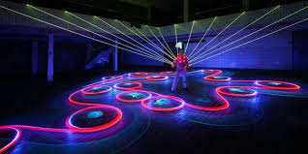
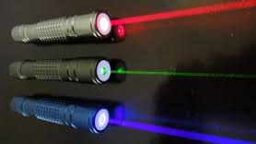
LASER
&
OPTICAL SOURCES
By: Sikandar Khan

Slide 2
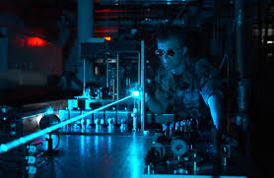
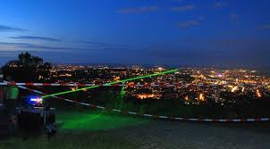
©irfan khan

Slide 3
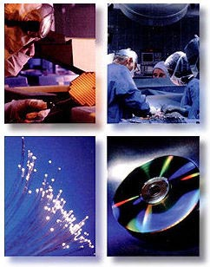
LASER
(semiconducting Lasers)
Sikandar Khan

Slide 4
A very brief history of light
IN THE BEGINNING - (c 4.5 Billion BC)
THE SUN - (c 4 Billion BC)
THE EARTH - (c 4 Billion BC)
EARLY LIFE - (c 3 Billion BC)
PHOTOSYNTHESIS - (c 2 Billion BC)
FIRST MAN - (c 1 Million BC)
EARLY MAN - (c 500,000 BC)
FIRE, FLAME and TORCH - (c 400,000 BC)
PRIMITIVE LAMPS - (c 13,000 BC)
ANIMAL LAMPS - (c 5000 BC)
EARLY LIGHTING - (3000 BC)
SUNDIAL - (c 1500 BC)
OIL POTTERY LAMPS - GREEK - (600 BC)
OIL RESERVOIR LAMP - (500 BC)
ROMAN - LIFE & LIGHT - (400 BC - 80 AD)
COLOR AND MUSIC (SOUND) - (c 350 BC)
EARLY OPTICS & LENSES - (c 300 BC)
HORN LANTERN - (c 100 AD)
CANDLE - (c 400)
CAMERA OBSCURA - (c 1000)
COLORS OF THE SPECTRUM - (1666)
POLARIZATION/POLARIZED LIGHT - (1678)
PHOTOGRAPHY, EARLY - (1727)
ADDITIVE COLOR MIXING - (1769)
BETTY LAMP (& BETSY LAMP) - (1790)
FIRST - GAS LIGHTING - (1792)
INFRARED - (c 1800)
ULTRAVIOLET LIGHT (UV) - (1801)
ELECTRIC ARC LIGHT/ CARBON ARC LIGHT - (1809)
PHOTOGRAPHY, MODERN - (1826)
SPEED OF LIGHT - (1849)
SPECTROSCOPE - (c 1850)
KEROSENE LAMP - (1853)
FIRST - FOLLOWSPOT SPOTLIGHT - (c 1856)
PHOTOGRAPHY, MOTION PICTURES - EARLY - (1872)
FIRST - ELECTRIC FILAMENT (INCANDESCENT) LAMP - (1874)
EDISON LAMP - (1879)
SWAN LAMP - (1879)
FIRST - PHOTOCELL - (1880)
ELECTRICITY - (1899)
HIGH INTENSITY DISCHARGE (HID) LAMP - (1901)
MERCURY-VAPOR LAMP - (1901)
TUNGSTEN FILAMENT LAMP - (1907)
GAS FILLED LAMP - (1913)
FLASHBULB - (1930)
SODIUM LAMP - (LOW PRESSURE) - (1932)
FLUORESCENT LAMP - (1937)
PHOTOGRAPHY - POLAROID CAMERA - (1947)
FIBER OPTICS - (1955)
LASER - (1960)
HOLOGRAM/HOLOGRAPHY - (a 1960)
QUARTZ HALOGEN LAMP - (1960)
LIGHT EMITTING DIODE - (a 1965)

Slide 5
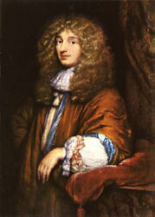
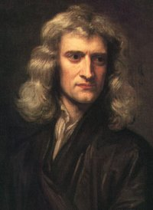
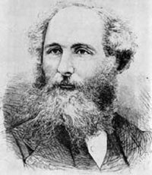
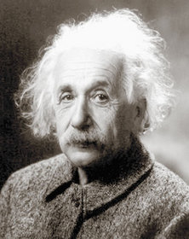
wave theory
Theories of light
corpuscular theory
Electromagnetic waves
Christiaan Huygens
1629–1695
photons
Sir Isaac Newton
1643 –1727
James Clerk Maxwell
1831–1879
Albert Einstein
1879–1955

Slide 6
Optical Sources
There are two types of light sources:
Light Emitting diode (LED)
LASER diodes (LD’s)
LED’s may have two types of source:
Surface-emitting LED
Edge-emitting LED
©irfan khan

Slide 7
Optical Sources
LASER diodes are:
Fabry- Perot
Distributed feed back (DFB)
Vertical cavity surface-emitting Laser (VCSEL)
All light emitters are complex semiconductors that convert an electrical current in to light.
©irfan khan

Slide 8
Optical Sources
The conversion process is fairly efficient as it creates very little heat compared to the heat generated by incandescent lights.
©irfan khan

Slide 9
Optical Sources
LED’s and Laser diodes are of interest because of five inherent characteristics.
Small size
High radiance (Emit a lot of light in a small area)
Small emitting area (Area is comparable to the dimension of optical fiber cores)
©irfan khan

Slide 10
Optical Sources
Very long life (offer high reliability)
Can be modulated at high speed
LED’s are used as visible indicator in most electronics equipment.
LASER diodes are most widely used in compact disk players.
©irfan khan

Slide 11
Optical Sources
The LED’s used in fiber optic differ from the more common indicator LED’s in two ways.
  The wavelength in generally in the near infrared because the optical loss of fiber is the lowest at these wavelengths.
  The LED emitting area is generally much smaller to allow the highest possible modulation bandwidth and improve the coupling efficiency with small core optical fibers.
©irfan khan

Slide 12
How Light is Generated
Atoms contain two specific types of energy:
Binding energy of nucleus.
Electron energy.
Electrons have different specific energy levels in which they move around the nucleus.
©irfan khan

Slide 13
How Light is Generated
Forbidden zone between each energy level is known as “Energy gap”.
For an electron to move from one energy level to another, it must gain or lose the exact energy difference between the two levels.
©irfan khan

Slide 14
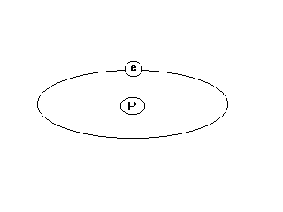
How Light is Generated
When the electron is orbiting in the nucleus at its lower energy level E₁ , it is said to be in its unexcited or ground state.
Bohr model of the hydrogen atom
©irfan khan

Slide 15
How Light is Generated
E5
E5
E4
434 nm
E2
E3
486 nm
656 nm
E1
+
r
E4
E2
97 nm
122 nm
103 nm
Ground state
E3
E1
Bohr model of the hydrogen atom showing permissible electron energy levels.
Energy level diagram of the hydrogen atom.
©irfan khan

Slide 16
How Light is Generated
Direct Transition.
When the stimulated electron drops directly back to its ground state, its called direct transition.
Indirect Transition.
When the electron returns to its ground state in two or more steps, its called indirect transition.
©irfan khan

Slide 17
How Light is Generated
The result of direct transition is emission of radiations of a single wavelength.
The result of indirect transition is the emission of radiations of two or more wavelengths.
©irfan khan

Slide 18
How Light is Generated
E5
Excited state
E4
E3
E2
Ground State
λ
=122nm
E1
Electron Energy Absorption
©irfan khan

Slide 19
How Light is Generated
E5
Excited state
E4
E3
λ
=122nm
E2
Ground State
E1
Direct transition
©irfan khan

Slide 20
How Light is Generated
E5
Excited state
E4
E3
E2
λ
Ground State
=103nm (UV)
E1
Indirect transition.
©irfan khan

Slide 21
How Light is Generated
E5
Excited state
E4
E3
λ
=656 nm (Visible Red)
E2
λ
=122nm(UV)
Ground State
E1
Indirect transition
©irfan khan

Slide 22
How Light is Generated
How an atom can be stimulated ?
Atom is stimulated by using light energy.
Energy can also be imparted to an atom by heat, Electrical force or by collision with other particles.
©irfan khan

Slide 23
Semiconductor Material
Semiconductors
  Conduction properties lie between conductor and insulator
  Conduction properties can be described by Energy Bands
  At low temperature conduction band is completely empty
  By raising the temperature, electron exited across the band gap.
©irfan khan

Slide 24
Light-Emitting Diodes (LEDs)
LED is a solid-state component and has nearly unlimited life expectancy.
It requires far less operating power.
©irfan khan

Slide 25
LED Operation
LED is a PN junction diode that emits light through the recombination of electrons and holes when current is forced through its junction.
©irfan khan

Slide 26
LED Operation
Emitted Photon
Recombined electron and hole
Emitted Photon
-
-
-
-
+
+
+
+
-
+
-
N-Type Region (Cathode)
-
-
-
-
+
+
+
+
P-Type Region (Anode)
+
-
-
-
-
-
-
+
+
+
+
-
+
-
-
-
-
-
+
+
+
+
-
+
-
-
+
Basic operation of a light emitting diode
©irfan khan

Slide 27
LED Driver Circuits
The optical output of LED is approximately proportional to the drive current.
LEDs are usually driven with either a digital signal or an analog signal.
The key concern is driving the LED so that maximum speed is achieved.
©irfan khan

Slide 28
LED Structures
LED for optical used should have
  Fast emission response time
  High quantum efficiency
  High confinement of the charge carrier to the active region of PN junction
©irfan khan

Slide 29
LED Structures
Radiance or brightness:
It is a measure ,in watts, of the optical power radiated into a unit solid angle per unit area of emitting surface
Emission response time:
It is the time delay between the application of a current pulse and the onset of optical emission.
Quantum efficiency:
It is related to fraction of injected electron-hole pairs that recombine radiatively.
©irfan khan

Slide 30
LED Structures
Charge carrier confinement:
It is used to achieve a high level of radiative recombination in the active region of the device.
Optical confinement:
It is used to prevent absorption of the emitted radiation by the material surrounding the pn junction
*By confining the charge carrier and optical emission high radiance and high quantum efficiency can be achieved
©irfan khan

Slide 31
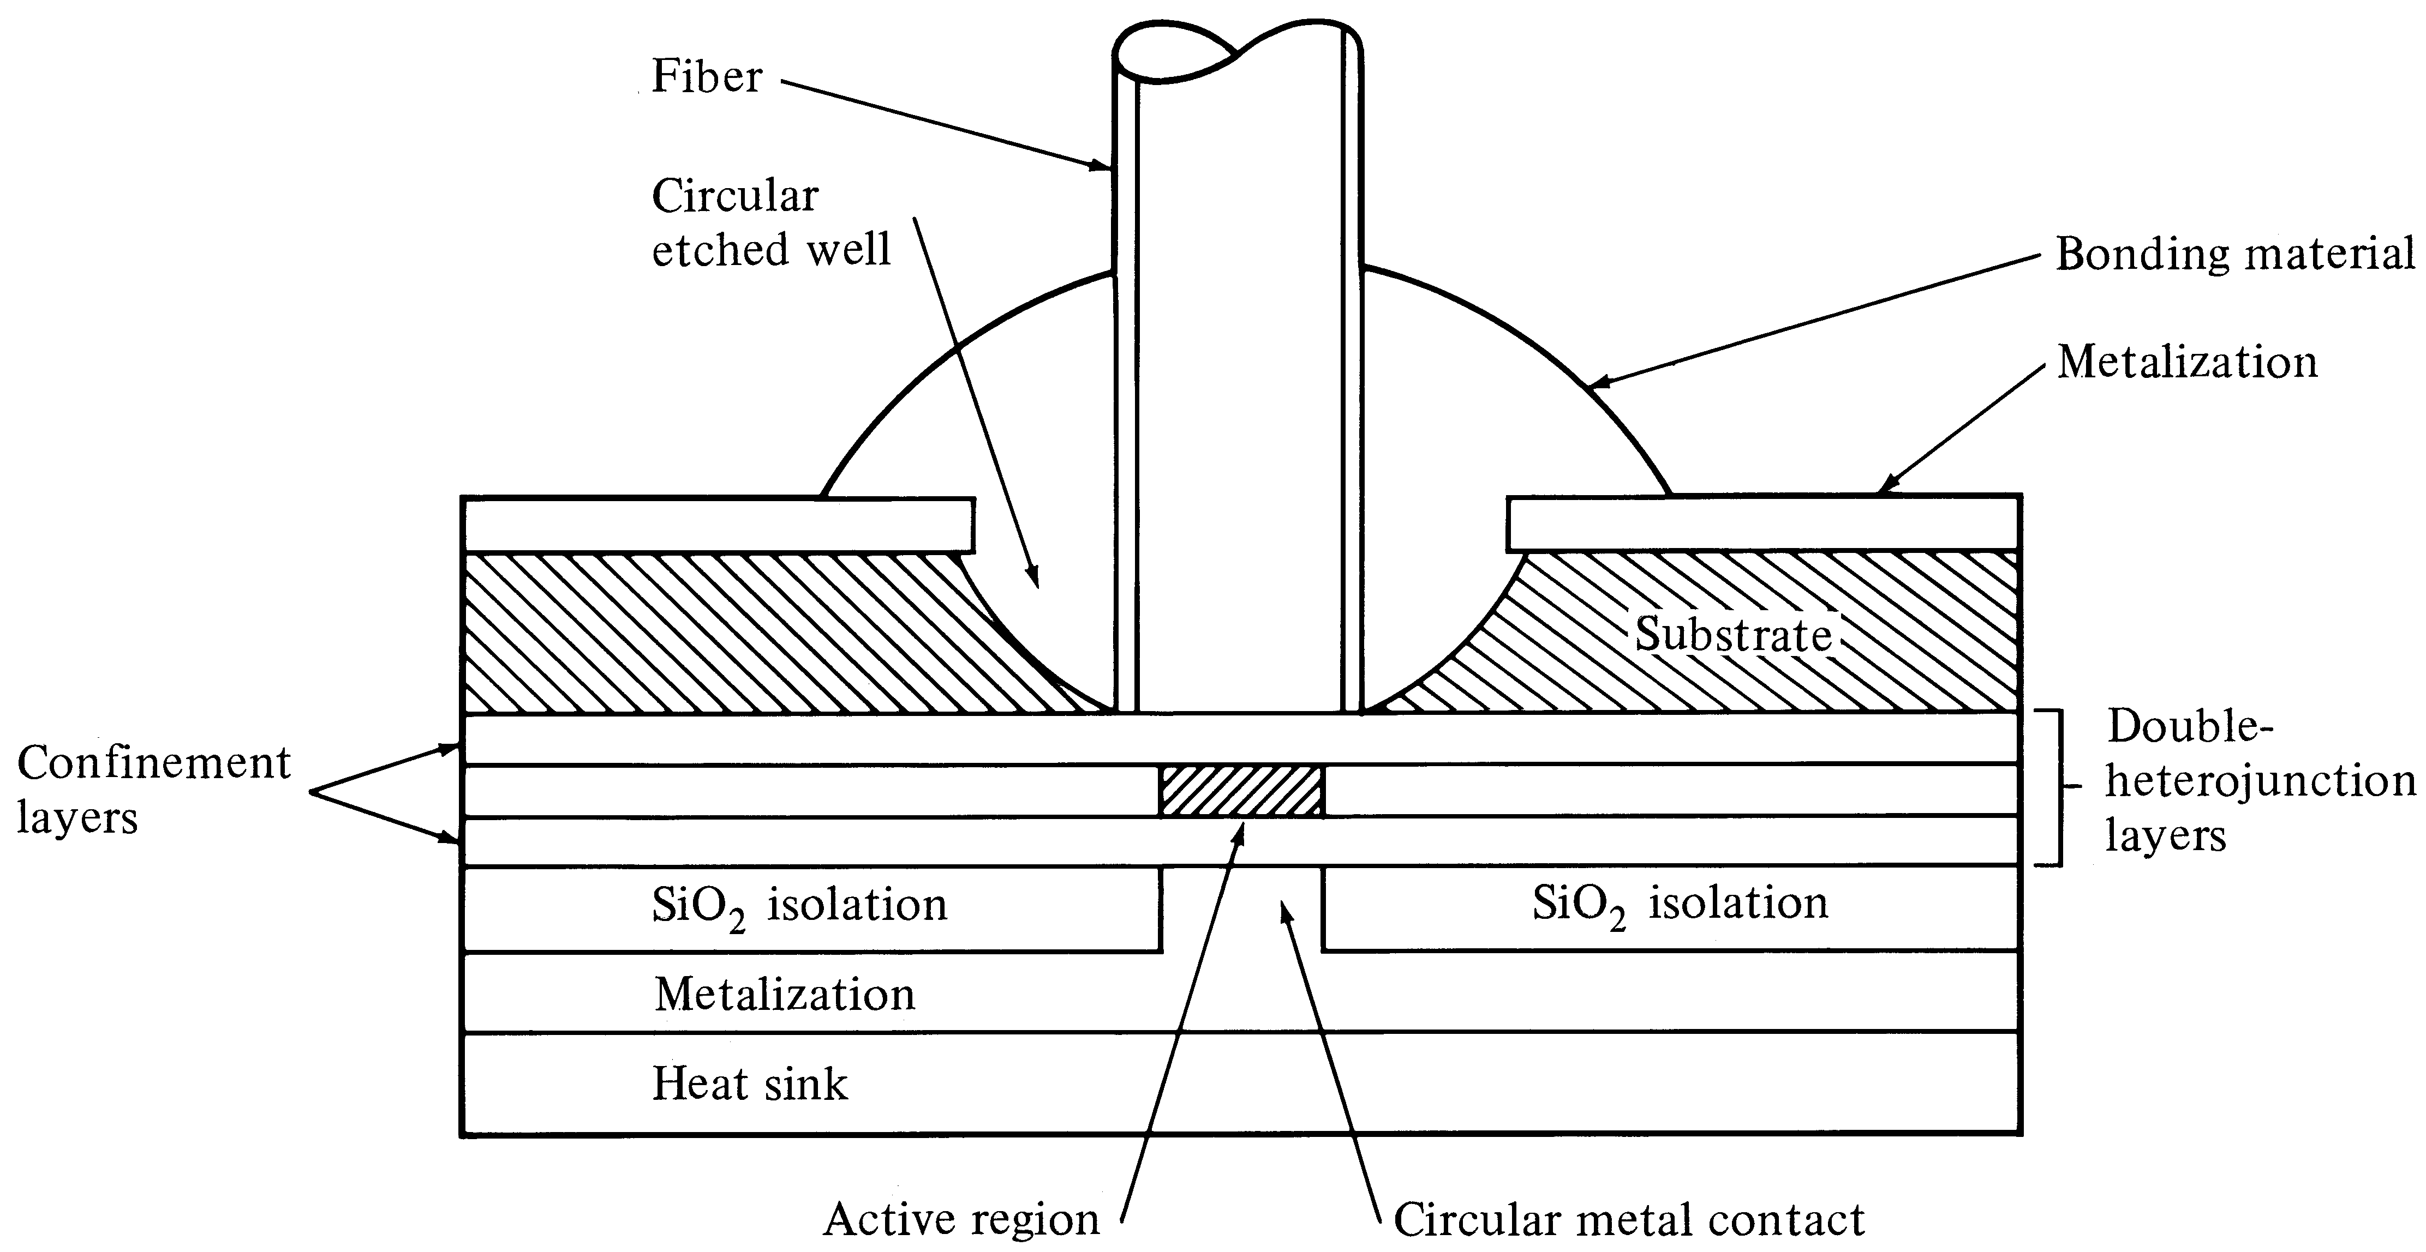
High radiance surface emitting LED. The active region is limited to a circular section having an area compatible with the fiber core end face
©irfan khan

Slide 32
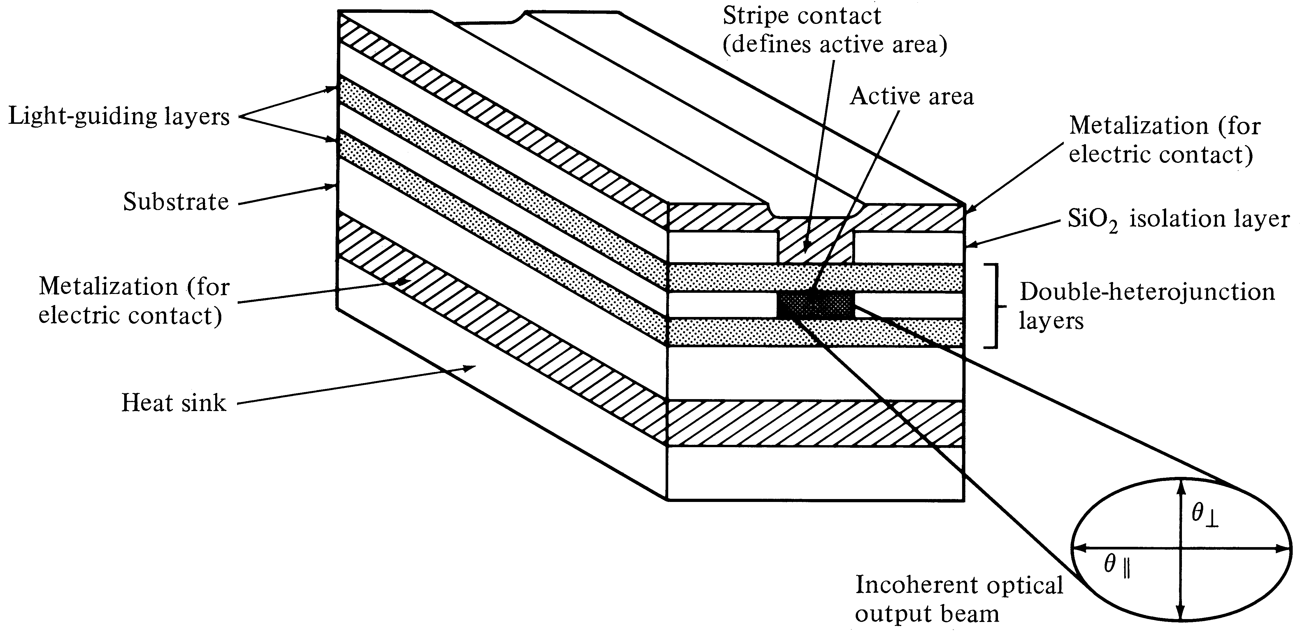
Edge emitting double heterojunction LED.
©irfan khan

Slide 33
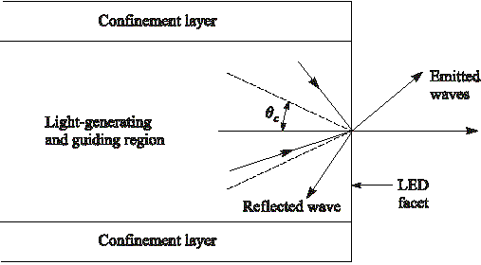
Light-emission cone
Only light falling within a cone defined by the critical angle will be emitted from an optical source.
©irfan khan

Slide 34
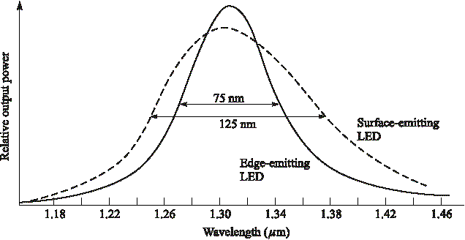
LED spectral patterns
©irfan khan

Slide 35
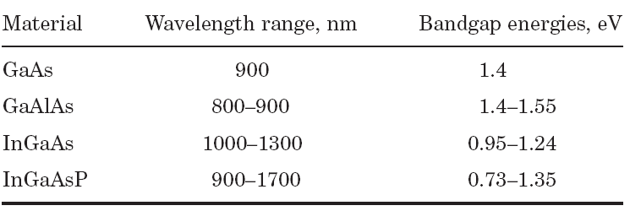
Some LED and Laser Diode Material Mixtures and their Characteristics
©irfan khan

Slide 36
Laser Diodes
“LASER” is an acronym of
Light Amplification by Stimulated Emission of Radiations.
©irfan khan

Slide 37
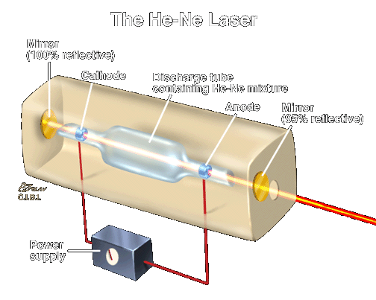
Fundamentals of Laser Operation

Slide 38
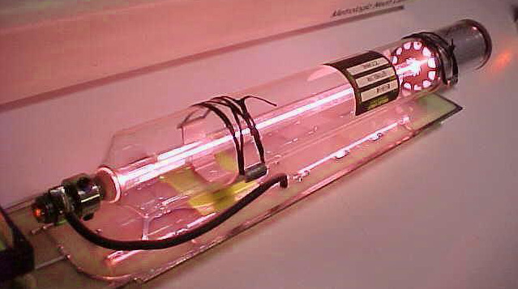
HELIUM-NEON GAS LASER
Courtesy of Metrologic, Inc.
Laser-Professionals.com
Notes:
Gas lasers use gas atoms in a tube as an active medium. The excitation mechanism is usually an electric current through the gas. The current excites gas atoms to the correct energy level for lasing to occur. Mirrors on each end of the tube are aligned to reflect the laser beam through the active medium. About 2% of the light passes through the output coupler at the lower left.
This photo is a typical 5 mW HeNe laser. This was the most common type of laser until the mid 1980s when reliable, low-cost diode lasers became available. HeNe lasers are still the second most common lasers. They provide higher beam quality than most diode lasers. They are widely used in scientific applications where low power, high quality beams are needed.
There are many other types of gas lasers. Argon lasers produce powerful blue beams and are used in scientific research, medical applications, and laser light shows. Carbon dioxide lasers produce beams with powers of thousands of watts and are used for cutting and welding metals. Other gas lasers find a wide range of applications.

Slide 39
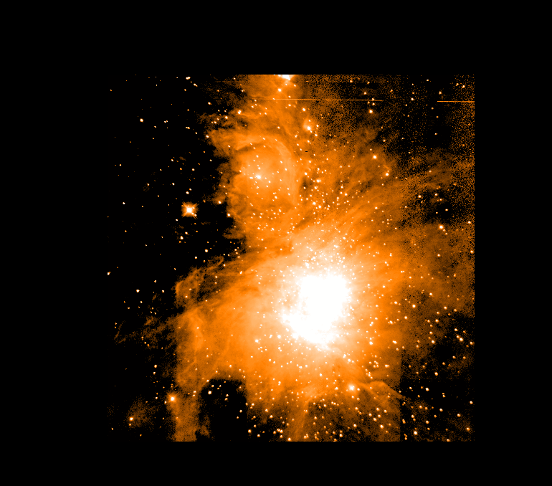
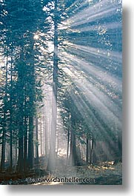
In the beginning there was no light …

Slide 40
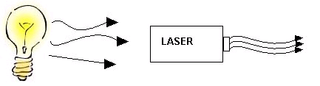
Incandescent vs. Laser Light
Many wavelengths
Multidirectional
Incoherent
Monochromatic
Directional
Coherent

Slide 41
Advantages:
Ideal laser light is single-wavelength only. This is not exactly true for communication lasers.
Lasers can be modulated (controlled) very precisely.
Lasers can produce relatively high power. Indeed some types of laser can produce kilowatts of power. In communication applications, semiconductor lasers of power up to about 20 milli watts are available
Because laser light is produced in parallel beams, a high percentage (50% to 80%) can be transferred into the fibre.
©irfan khan

Slide 42
Disadvantages:
Lasers have been quite expensive by comparison with LEDs.
Reason: Temperature control and output power control is needed.
The wavelength that a laser produces is a characteristic of the material used to build it and of its physical construction. Lasers have to be individually designed for each wavelength they are going to use.
©irfan khan

Slide 43
LASER BEAM INJURIES
High power lasers can cause skin burns.
Lasers can cause severe eye injuries
resulting in permanent vision loss.
Laser-Professionals.com
Notes:
Laser injuries result from two types of effects, thermal and photochemical.
Thermal injuries are caused by heating of the tissue as a result of the absorption of laser energy. This causes proteins to be “denatured” (cooked) and results in a burn. Thermal burns can occur at all wavelengths. They are the most common injury to eyes and skin for CW and long pulse lasers.
Micro-cavitation is a type of thermal effect that occurs when a short laser pulse is focused onto the retina. Most of the pulse energy is absorbed in a small volume heating the water in that volume to steam. This results in a microscopic steam explosion that separates retinal layers and ruptures blood vessels in the retina. This occurs with pulse durations of less than 18 μs for 400 to 1050 nm and less than 50 μs for 1050 to 1400 nm. This kind of injury results in significant vision loss and is the greatest risk for short pulse visible and near IR lasers.
Photochemical injuries occur because high energy photons break molecular bonds inside living cells. This creates molecular fragments that are toxic and injure the cell. These effects are most significant in the ultraviolet, but blue light can cause an injury to the retina that is similar to sunburn on skin. This results in permanent vision loss. Other UV photochemical effects include “welder’s flash”, cataracts, and skin cancer from long term low level exposures.

Slide 44
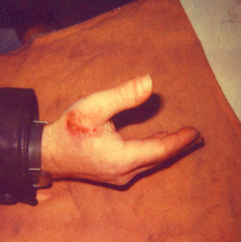
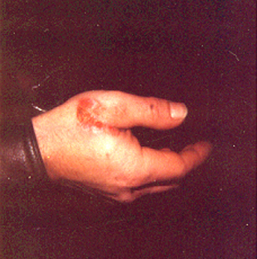
SKIN BURN FROM CO2 LASER EXPOSURE
Accidental exposure to partial reflection of 2000 W CO2 laser beam
from metal surface during cutting
Laser-Professionals.com
Notes:
Most laser skin injuries are thermal in nature. Exposure to high power beams at all wavelengths can result in skin burns. These burns usually do not lead to long-term disability, but they can have painful short-term consequences. Far IR light, such as that from CO₂ lasers, is absorbed strongly by water in the skin and results in a surface burn. Near IR light with wavelengths close to 1 μm, such as that from a Nd:YAG laser, penetrates more deeply into tissue and can result in deeper, more painful burns.
If a high power laser beam is focused on the skin, it can vaporize tissue and drill a hole or produce a cut if the beam or tissue is moving. CW beams will cauterize the tissue preventing bleeding. Focused short pulses form repetitive pulse Q-switched lasers vaporize tissue without heating the surrounding tissue enough to cauterize. Exposures to focused Q-switched beams can result in cuts several millimeters deep that bleed freely.
Photochemical skin injuries include sunburn and the possibility of promoting skin cancer by repeated low level exposures over long periods of time. The best way to avoid this issue is to enclose high power UV beams.

Slide 45
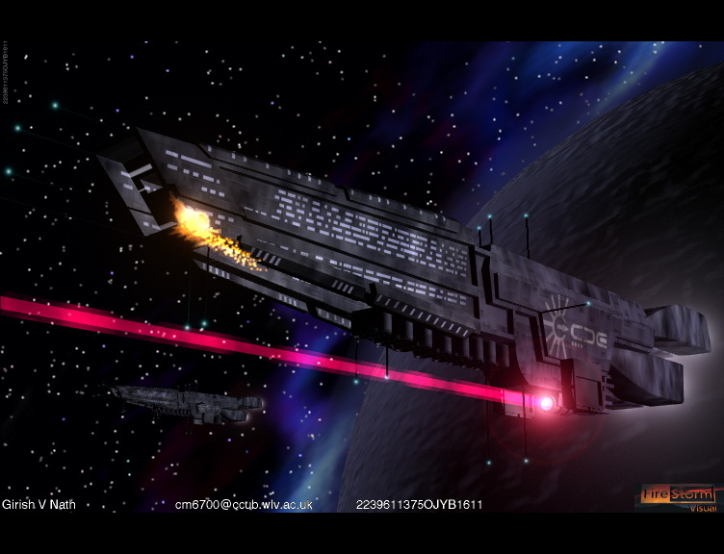
©irfan khan

Slide 46
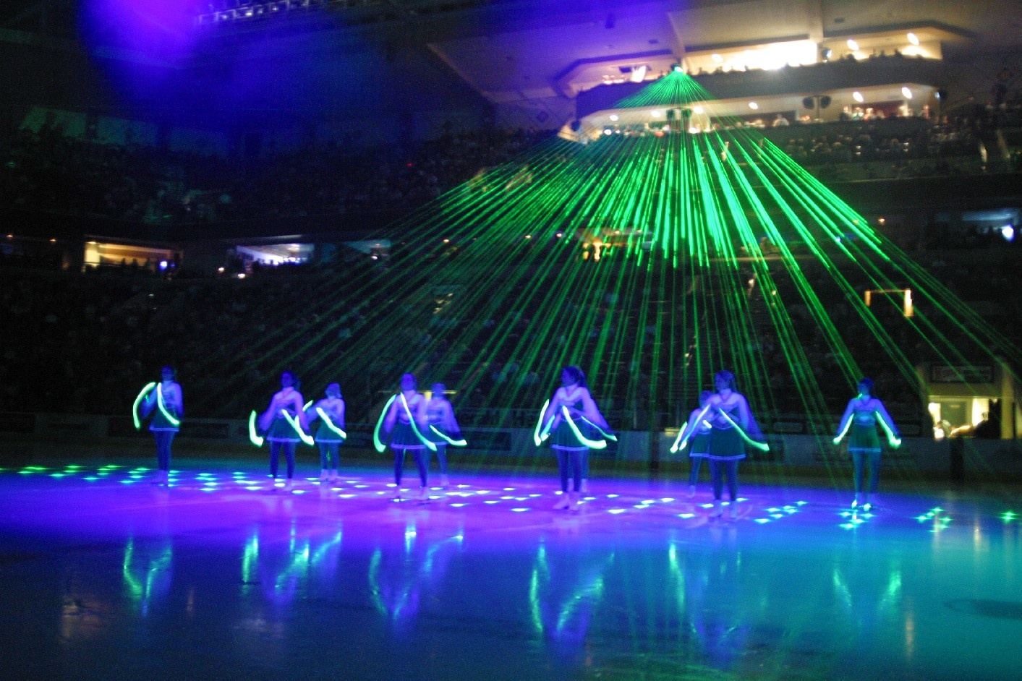
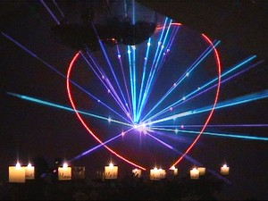
Laser shows

Slide 47
COMPARE LIGHT FROM A LASER AND A FLASHLIGHT
Monochromatic
  laser is single color; flashlight has rainbow spectrum
Coherent
  Laser Speckle- due to wave interference
Highly Directional
  Flashlight beam spreads much more than laser’s
  Define Irradiance = Power/area; laser is lower power but much smaller area
Judy Donnelly
Three Rivers Community College

Slide 48
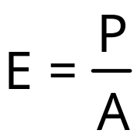
What is Irradiance?
Irradiance depends on both laser power and on the area being irradiated. It is a concept of central importance in laser safety. The symbol for irradiance is “E”, and the units are usually mW/cm².
Judy Donnelly
Three Rivers Community College

Slide 49
EXAMPLE: CALCULATION of IRRADIANCE
A 5 mWatt laser makes a 2 mm by 3 mm spot on a wall.
Find the irradiance.
Power = 5 mWatt
Area = 0.2 cm x 0.3 cm = 0.06 cm²
Irradiance = Power/Area = 5 mWatt / 0.06 cm²
= 83 mWatt / cm²
Judy Donnelly
Three Rivers Community College

Slide 50
Laser Safety Standards
Several organizations oversee standards for laser safety:
ANSI American National Standards Institute
  _{Reference for laser users}
CDRH Center for Devices and Radiological Health
  Product safety standards for laser manufacturers
OSHA Occupational Safety and Health Administration
  Enforces regulations in the workplace
IEC International Electrotechnical Commission
  International standards organization, with 60 member countries
Judy Donnelly
Three Rivers Community College

Slide 51
Laser Eye Hazards
The eye is the part of the body most vulnerable to laser hazards. Changes to the eye can occur at much lower laser power levels than changes to the skin. And, eye injuries are generally far more serious (life altering) than injuries to the skin.
lens
fovea
cornea
retina
iris
optic nerve
pupil
Judy Donnelly
Three Rivers Community College

Slide 52
Irradiance at the Retina
Example
A laser pointer produces a 2-mW beam. The beam enters the eye and is focused by the cornea and lens to a spot on the retina 16 um in diameter.
Find:
The irradiance on the retina, assuming that all of the 2 mW of power is focused on the retina.
Solution:
Area of spot
A = πd²/4
= π(1.6 x 10⁻³cm)²/4
= 2 x 10⁻⁶ cm²
Irradiance:
E = P/A
= 2 mW/[2 x 10⁻⁶ cm²]
= 1000 W/cm²
lens
cornea
retina
pupil
Rule of thumb: The optics of the eye increase irradiance by a factor of 100,000!
Judy Donnelly
Three Rivers Community College

Slide 53
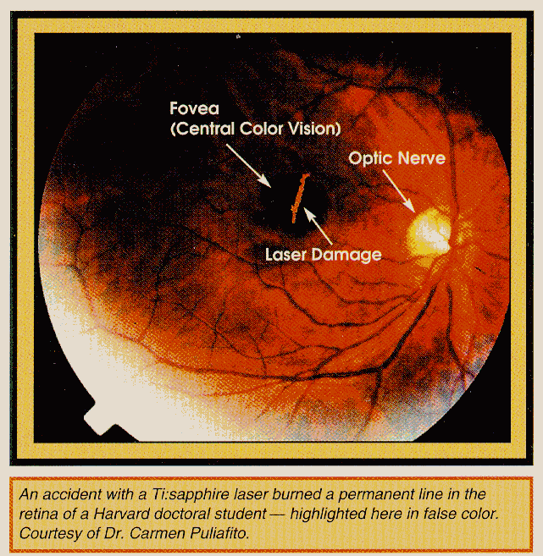
Example of retinal damage due to laser exposure
Judy Donnelly
Three Rivers Community College

Slide 54
Not all viewing conditions are the same
Specular reflection Convex reflector Concave reflector
Whether a reflection is specular or diffuse for a given surface depends on the laser wavelength. “Smooth” is relative to the laser wavelength.
Diffuse reflection
Judy Donnelly
Three Rivers Community College

Slide 55
LASER SKIN HAZARDS
Thermal hazards (skin burns) from high level of optical radiation
Photochemical hazards (accelerated aging and risk of
skin cancer) due to ultraviolet radiation
Judy Donnelly
Three Rivers Community College

Slide 56
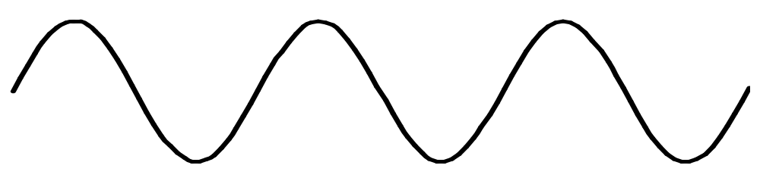
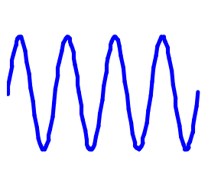
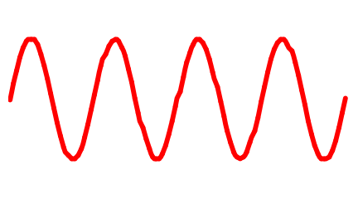
WAVE NATURE OF LIGHT
λ
Wavelength
Blue: λ = 400 nm
Light is an electromagnetic wave.
Different wavelengths in the visible spectrum are seen by the eye as different colors.
Red: λ = 700 nm
Laser-Professionals.com
Notes:
Light is an electromagnetic wave. It consists of oscillating electric and magnetic fields traveling through space. This figure is a representation of the electric field of a light wave.
The wavelength is the distance between two peaks on the wave. Different wavelengths are seen by the eye as different colors. Blue light has a wavelength of about 400 nm (0.4 μm). Red light has a wavelength of about 700 nm (0.7 μm). (1 nm = 10⁻⁹ m; 1 μm = 10⁻⁶ m)
For about three hundred years there was a disagreement among scientists about the nature of light. Some believed light was a wave and others believed that light was a particle. Both factions were eventually able to support their positions with experimental evidence. It was not until the beginning of the twentieth century that the answer was discovered. When light travels through space, it acts like a wave. When light is emitted or absorbed by an atom, it acts like a particle.
The “particle” of light is called a photon. It is not a material particle but rather a “quantum” that acts as though it is located in one place and has definite energy and momentum, like an ordinary particle. A photon is more accurately described as a packet of energy. The energy of a photon is related to the wavelength of the light. Shorter wavelength photons have more energy than long wavelength photons.

Slide 57

ELECTROMAGNETIC SPECTRUM
Visible
Radio
Gamma Ray
X-ray
Ultraviolet
Infrared
Microwaves
Radio
Short Wavelength
Long Wavelength
Lasers operate in the ultraviolet, visible, and infrared.
Laser-Professionals.com
Notes:
The electromagnetic spectrum extends from gamma rays at the short wavelength end to radio waves at the long wavelength end. The visible spectrum is a narrow slice somewhere in the middle, with blue light at the short wavelength end and red light at the long wavelength end.
The next shortest wavelength region from the visible is the ultraviolet. Ultraviolet light causes sunburn, skin cancer, and cataracts.
The next longest wavelength region from the visible is the infrared. Infrared light is invisible to the eye but can be felt as heat. It can cause burns to the skin or eyes.
Lasers operate in the ultraviolet, visible, and infrared regions of the spectrum. Lasers in each spectral region present unique safety issues.

Slide 58
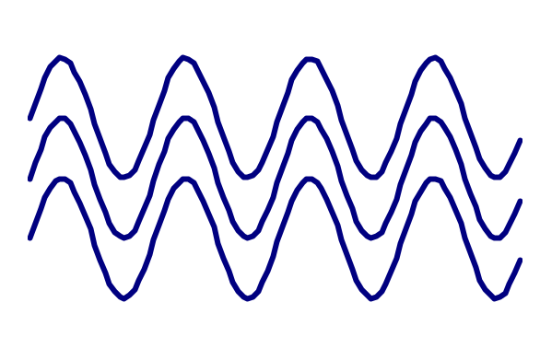
CHARACTERISTICS OF LASER LIGHT
MONOCHROMATIC
DIRECTIONAL
COHERENT
The combination of these three properties makes laser light focus 100 times better than ordinary light
Laser-Professionals.com
Notes:
Laser light has three characteristics that are different from ordinary light.
The monochromatic property of laser light means it is all one wavelength.
The directional property of laser light means that the beam spreads very slowly.
The coherent property of laser light means that all the light waves are in phase.
From a safety standpoint the most significant result of the characteristics of laser light is that laser light is focused to a very small spot by a lens. Each of the characteristics of laser light reduces the size of the focused spot.
Monochromatic light focuses better than light of many wavelengths.
The more directional a beam is, the smaller the focused spot will be.
Coherent light interferes constructively to intensify the focal spot and make it smaller.
This means that laser light can be concentrated on the retina of the eye by as much as 100 times more than ordinary light. Thus, even relatively low levels of laser light can produce significant eye hazards.

Slide 59
An Ideal Beam of LASER Radiation
©irfan khan

Slide 60
Properties of LASER
LASER has three main characteristics:
Monochromatic
Coherent
Collimated
©irfan khan

Slide 61
Properties of LASER
Monochromatic
Radiation which occurs at a single wavelength or color.
©irfan khan

Slide 62
Properties of LASER
Coherent
It means all waves vibrate in step, there by constructively reinforcing each adjacent wave.
A.
=
Coherent light
Constructive interference
B.
=
Incoherent light
Destructive interference
OPTICAL INTERFERENCE
©irfan khan

Slide 63
Properties of LASER
Collimated
It means rays are travelling in the same direction on parallel paths.
Collimating lens
Source
Source
Target area
A
B
©irfan khan

Slide 64
LASER Principles
Laser action is the result of three key process
  Photon absorption
  Spontaneous emission
  Stimulated emission
©irfan khan

Slide 65
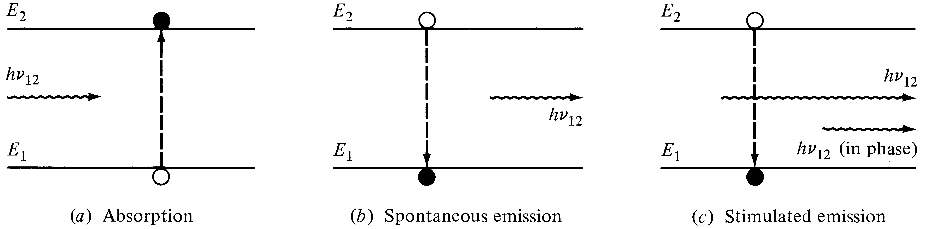
Laser transition processes
©irfan khan

Slide 66
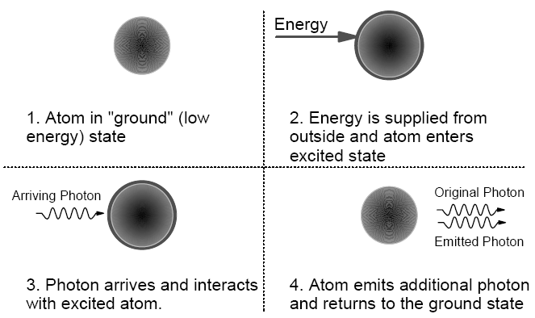
LASER Principles
©irfan khan

Slide 67
LASER Principles
Spontaneous emission
When an electron is elevated to a high energy state this state is usually unstable.
Electron will spontaneously return to a more stable state very quickly (within a few picoseconds) emitting a photon as it does so.
When light is emitted spontaneously:
Its direction and phase will be random
Wavelength will be determined by the amount of energy that the emitting electron must give up.
©irfan khan

Slide 68
LASER Principles
Stimulated emission
In some situations when an electron enters a high energy (excited) state it is able to stay there for a relatively long time (a few microseconds) before it changes state spontaneously.
When an electron is in this semi-stable (metastable) high energy state it can be “stimulated” by the presence of a photon of light to emit its energy in the form of another photon.
©irfan khan

Slide 69
Stimulated emission
**It is of fundamental importance to understand that when stimulated emission takes place the emitted photon has exactly the same wavelength, phase and direction as that of the photon which stimulated it.
**The photon that triggered (stimulated) the emission itself is not absorbed and continues along its original path accompanied by the newly emitted photon.
©irfan khan

Slide 70
LASER Principles
Photon absorption
E2
E1
©irfan khan

Slide 71
LASER Principles
Absorption
E5
Excited state
E4
E3
E2
λ
=122nm
Ground State
E1
©irfan khan

Slide 72
LASER Principles
  Spontaneous emission
E2
E1
©irfan khan

Slide 73
LASER Principles
Spontaneous Emission
E5
Excited state
E4
E3
λ
=122nm
E2
Ground State
E1
©irfan khan

Slide 74
LASER Principles
Stimulated emission
E2
E1
©irfan khan

Slide 75
LASER Principles
Stimulated Emission
E5
Excited state
E4
E3
λ
=122nm
E2
Ground State
E1
©irfan khan

Slide 76
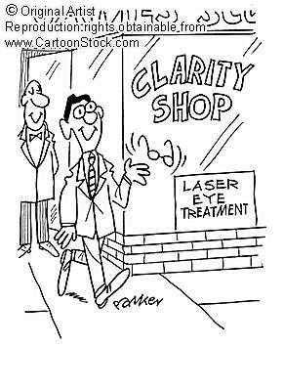
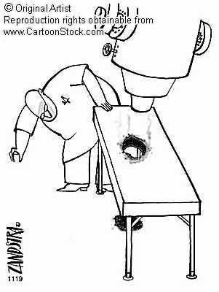
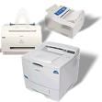
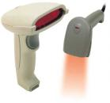
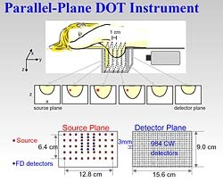

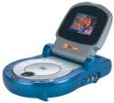

Laser usages
precision
CD player
scanner
printer
power
cutting, laser surgery
temporal precision
probe fast processes
high temperature
fusion
photodynamic therapy
cheaper / safer imaging
photo density waves

Slide 77
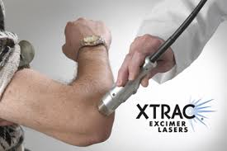
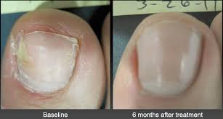
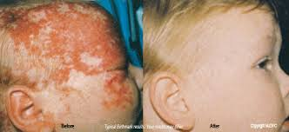
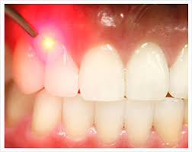
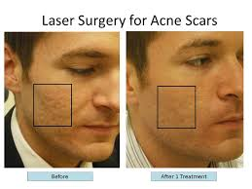
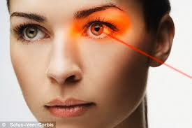
LASER Treatments
©irfan khan

Slide 78

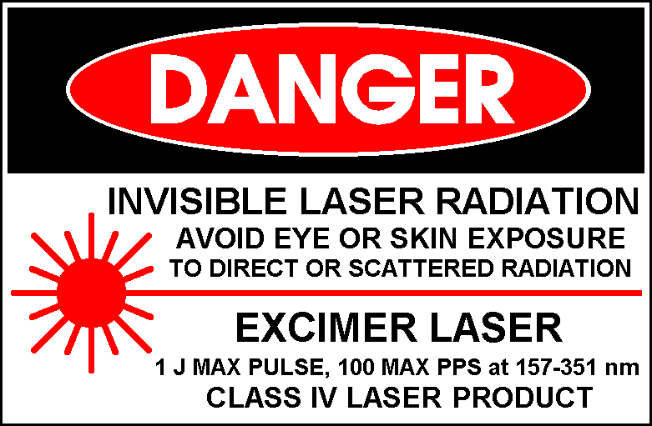

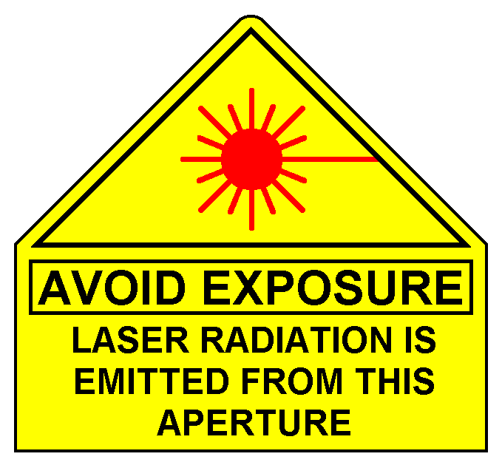

Common Laser Signs and Labels

Slide 79
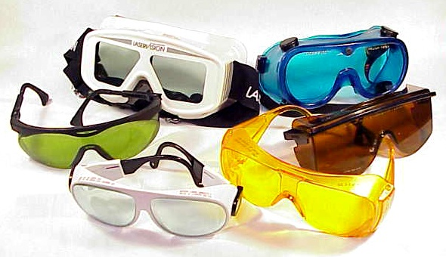
LASER SAFETY EYEWEAR
Laser-Professionals.com
Notes:
Laser safety eyewear is available in glass or plastic for all laser wavelengths. The required Optical Density of the eyewear is determined in the hazard analysis performed by the LSO.
Eyewear should never be viewed as the first control measure to be applied. In all cases engineering and procedural controls should be devised to reduce and limit the possible exposure to hazardous laser light. The use of eyewear should then be required as a last line of defense in case everything else fails. Most laser eye injuries have occurred when other controls proved inadequate and the worker was not wearing eyewear.
Eyewear would have prevented most laser eye injuries, but it does not make the wearer invulnerable. It is never safe to stare into a laser beam, even if wearing laser protective eyewear.
The greatest risk of eye injury occurs when near IR lasers are operated with the beam exposed.
Eyewear should always be worn when a near IR class 3b or class 4 beam is accessible.

Slide 80
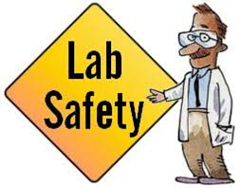
©irfan khan

Slide 81
SAFETY RULES FOR LAB LASERS
Avoid looking directly into any laser beam or at its reflection.
Be aware of the beam’s location.
Only trained qualified personnel should work with lasers
Don’t let friends and visitors to the lab play with the lasers
Keep room lights on whenever possible
Remove all watches, jewel and unnecessary specular (shiny) reflecting surfaces from the work area.
Don’t bend down below beam height
Use beam blocks
Wear laser safety eyewear
Report accidents immediately.
In the case of eye exposure consult an opthalmologist.
Judy Donnelly
Three Rivers Community College

